Slide 1
An Overview of
Machine Learning

Slide 2
“People worry that computers will get too smart and take over the world, but the real problem is that they're too stupid and they've already taken over the world.” ― Pedro Domingos

Slide 3
What is machine learning?
A branch of artificial intelligence, concerned with the design and development of algorithms that allow computers to evolve behaviors based on empirical data.
As intelligence requires knowledge, it is necessary for the computers to acquire knowledge.
Machine learning algorithms are used to learn the structure of the data. Is there structure in the data? Can we learn the structure from the data? And if we can, we can then use it for prediction , description, compression, and what not.
"Machine learning is using data to answer questions" — Yufeng Guo

Slide 4
Terminology
Training Data: refers to using our data to find patterns between the variables. An algorithm, or formula, is then computed from this pattern.
Model: refers to our machine learning algorithm/formula. This algorithm is then used for our prediction
Prediction: refers to answering our questions from the data.
Independent/Predictor Variable(s): are the variables used to help predict your dependent variable.
Dependent/Explanatory Variable: it is the variable you want to explain or predict.

Slide 5
How Machine Learning Algorithms Work
You get your data
Find Patterns in the Data (Training)
Create a model (algorithm) out of the pattern
Use model to predict our answers on new data
Update the model with new data

Slide 6
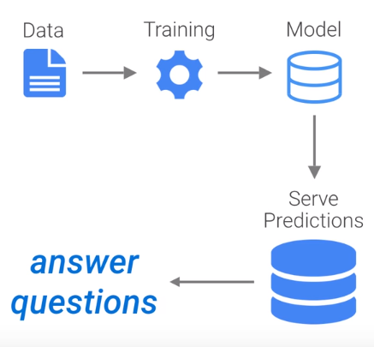
How Machine Learning Algorithms Work (Conti.,)

Slide 7
Learning system model
Testing
Input Samples
Learning Method
System
Training

Slide 8
Training and testing
Data acquisition
Practical usage
Universal set
(unobserved)
Training set (observed)
Testing set
(unobserved)

Slide 9
Training and testing
Training is the process of making the system able to learn.
No free lunch rule:
  Training set and testing set come from the same distribution
  Need to make some assumptions or bias

Slide 10
Performance
There are several factors affecting the performance:
  Types of training provided
  The form and extent of any initial background knowledge
  The type of feedback provided
  The learning algorithms used
Two important factors:
  Modeling
  Optimization

Slide 11
Algorithms
The success of machine learning system also depends on the algorithms.
The algorithms control the search to find and build the knowledge structures.
The learning algorithms should extract useful information from training examples.

Slide 12


Algorithms
Supervised learning ( )
  Prediction
  Classification (discrete labels), Regression (real values)
Unsupervised learning ( )
  Clustering
  Probability distribution estimation
  Finding association (in features)
  Dimension reduction
Semi-supervised learning
Reinforcement learning
  Decision making (robot, chess machine)

Slide 13
Algorithms
Supervised learning
Unsupervised learning
Semi-supervised learning

Slide 14
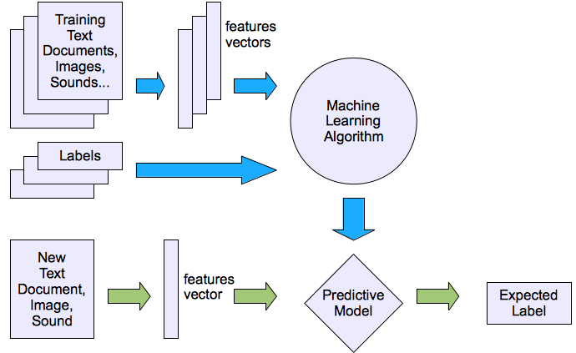
Machine learning structure
Supervised learning

Slide 15
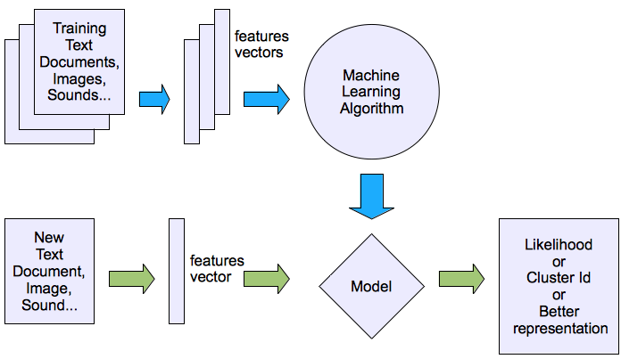
Machine learning structure
Unsupervised learning

Slide 16
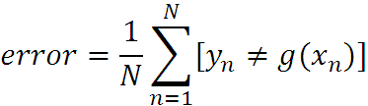
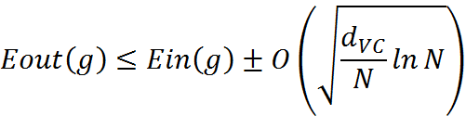
What are we seeking?
Supervised: Low E-out or maximize probabilistic terms
Unsupervised: Minimum quantization error, Minimum distance, MAP, MLE(maximum likelihood estimation)
E-in: for training set
E-out: for testing set

Slide 17




What are we seeking?
Under-fitting VS. Over-fitting (fixed N)
error
(model = hypothesis + loss functions)

Slide 18
Learning techniques
Supervised learning categories and techniques
  Linear classifier (numerical functions)
  Parametric (Probabilistic functions)
    Naïve Bayes, Gaussian discriminant analysis (GDA), Hidden Markov models (HMM), Probabilistic graphical models
  Non-parametric (Instance-based functions)
    K-nearest neighbors, Kernel regression, Kernel density estimation, Local regression
  Non-metric (Symbolic functions)
    Classification and regression tree (CART), decision tree
  Aggregation
    Bagging (bootstrap + aggregation), Adaboost, Random forest

Slide 19

Learning techniques
Linear classifier
Techniques:
  Perceptron
  Logistic regression
  Support vector machine (SVM)
  Ada-line
  Multi-layer perceptron (MLP)
, where w is an d-dim vector (learned)

Slide 20
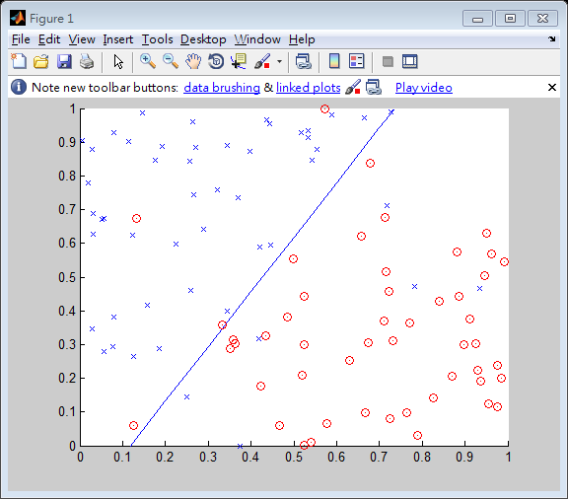
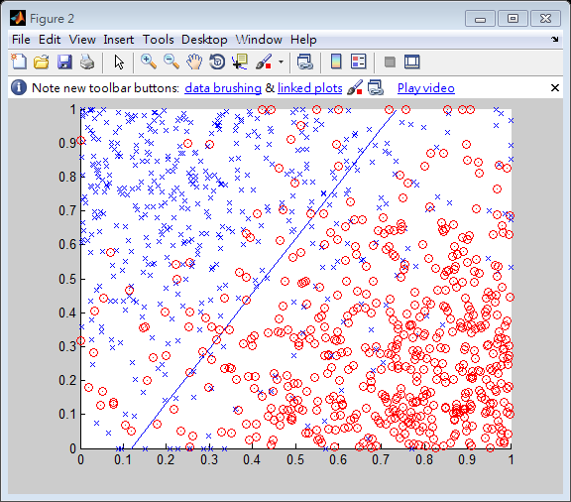
Learning techniques
Using perceptron learning algorithm(PLA)
Training
Testing
Error rate: 0.10
Error rate: 0.156

Slide 21
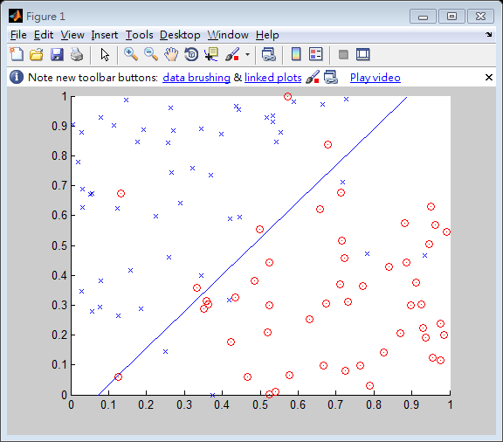
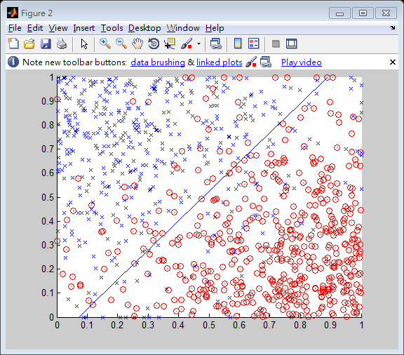
Learning techniques
Using logistic regression
Training
Testing
Error rate: 0.11
Error rate: 0.145

Slide 22



Learning techniques
Non-linear case
Support vector machine (SVM):
  Linear to nonlinear: Feature transform and kernel function

Slide 23
Learning techniques
Unsupervised learning categories and techniques
  Clustering
    K-means clustering
    Spectral clustering
  Density Estimation
    Gaussian mixture model (GMM)
    Graphical models
  Dimensionality reduction
    Principal component analysis (PCA)
    Factor analysis

Slide 24
Different Ways to Evaluate Model Performance
Predictive Accuracy: How many does it get right?
Speed: How fast does it take for the model to deploy?
Scalability: Can the model handle large datasets?
Robustness: How well does the model handle outliers/missing values?
Interpretability: Is the model easy to understand?

Slide 25
How to Improve your Learning Algorithm?
Get more training examples
Try smaller set of features (take some features away or select some good ones to prevent overfitting)
Try getting more features (could be time consuming for huge projects)

Slide 26
Applications
Face detection
Object detection and recognition
Image segmentation
Multimedia event detection
Economical and commercial usage

Slide 27
Conclusion
We have a simple overview of some techniques and algorithms in machine learning. Furthermore, there are more and more techniques apply machine learning as a solution. In the future, machine learning will play an important role in our daily life.

Slide 28
Reference
W. L. Chao, J. J. Ding, “Integrated Machine Learning Algorithms for Human Age Estimation”, NTU, 2011.
Thomas Mitchell (1997), Machine Learning, Mcgraw-Hill.
R. Duda, P. Hart, and D. Stork (2000), Pattern Classification, Second Edition.
Ian H. Witten, Eibe Frank, Mark A. Hall (2011), Data Mining: Practical Machine Learning Tools and Techniques, Third Edition, The Morgan Kaufmann
Oded Maimon, Lior Rokach (2010), Data Mining and Knowledge Discovery Handbook, Second Edition, Springer.

